Slide 1


Virtualization for Cloud Computing
IMS ENGINEERING COLLEGE, GHAZIABAD
Mr. Ghanshyam Yadav
Assistant Professor
Deptt. of Computer Sciences & Engineering
IMSEC, Ghaziabad, UP
Ghanshyam.yadav@imsec.ac.in
Yadavgh.yam2001@gmail.com

Slide 2
CLOUD COMPUTING
On demand provision of computational resources (Infrastructure, Platform, Software).
Requires high availability of resources and optimum use.
Virtualization is the enabling technology and creates virtual machines that allows a single machine to act as if it were many machines.
Benefits of virtualization for cloud computing: Reduces capital expenses and maintenance costs through server consolidation, reduces physical space needed in data centers. Resource Management, Migration, Maintainability, High availability and Fault tolerance are other benefits.
Virtualization is implemented using hypervisors.

Slide 3
VIRTUALIZATION
Machine Stack showing
virtualization opportunities
Creation of a virtual version of hardware using software.
Runs several applications at the same time on a single physical server by hosting each of them inside their own virtual machine.
By running multiple virtual machines simultaneously, a physical server can be utilized efficiently.
Primary approaches to virtualization
  Platform virtualization Ex : Server
  Resources virtualization Ex : Storage,
  Network
Application
Libraries
Operating System
Hardware

Slide 4
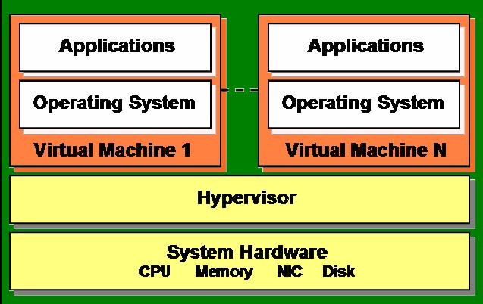
HYPERVISOR
Hypervisor plays an important role in the virtualization scenario by virtualization of hardware. It provides support for running multiple operating systems concurrently in virtual servers created within a physical server.
The virtualization layer is the software responsible for hosting and managing all VMs. The virtualization layer is a hypervisor running directly on the hardware.
Example: VMWare, Xen, KVM.

Slide 5

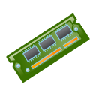
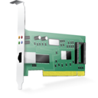

SERVER WITHOUT VIRTUALIZATION
Hardware
CPU Memory NIC DISK
Only one OS can run at a time within a server.
Under utilization of resources.
Inflexible and costly infrastructure.
Hardware changes require manual effort and access to the physical server.
Operating System
Multiple Software Applications

Slide 6



SERVER WITH VIRTUALIZATION
Hardware
CPU Memory NIC DISK
Hypervisor
Can run multiple OS simultaneously.
Each OS can have different hardware configuration.
Efficient utilization of hardware resources.
Each virtual machine is independent.
Save electricity, initial cost to buy servers, space etc.
Easy to manage and monitor virtual machines centrally.
Virtual Server 1
Virtual Server 2
Operating System
Operating System
Multiple Software Applications
Multiple Software Applications

Slide 7
HYPERVISOR TYPE
Hardware
CPU Memory NIC DISK
Hypervisor
Full virtualization
Enables hypervisors to run an unmodified guest operating system (e.g. Windows 2003 or XP).
Guest OS is not aware that it is being virtualized.
E.g.: VMware uses a combination of direct execution and binary translation techniques to achieve full virtualization of server systems.
Virtual Server 1
Virtual Server 2
Operating System
Operating System
Multiple Software Applications
Multiple Software Applications
Notes:
Some guest operating systems hosted in full virtualization mode, can be configured to run the Novell* Virtual Machine Drivers instead of drivers originating from the operating system. Running virtual machine drivers improves performance dramatically on guest operating systems, such as Windows XP and Windows Server 2003.

Slide 8

HYPERVISOR TYPE
Hardware
CPU Memory NIC DISK
Hypervisor / VMM
Virtual Server 1
Virtual Server 2
Para virtualized Guest
Operating System
Para virtualized Guest
Operating System
Para virtualization
Involves explicitly modifying guest operating system (e.g. SUSE Linux Enterprise Server 11) so that it is aware of being virtualized to allow near native performance.
Improves performance.
Lower overhead.
E.g.: Xen supports both Hardware Assisted Virtualization (HVM) and Para-Virtualization (PV).
Multiple Software Applications
Multiple Software Applications
Notes:
Paravirtual mode does not require the host computer to support hardware-assisted virtualization technology, but does require the guest operating system to be modified for the virtualization environment. Typically, operating systems running in paravirtual mode enjoy better performance than those requiring full virtualization mode.
Operating systems currently modified to run in paravirtual mode are referred to as paravirtualized operating systems and include SUSE Linux Enterprise Server 11 and NetWare® 6.5 SP8.

Slide 9
HYPERVISOR IMPLEMENTATION APPROACHES
Bare metal Approach
Type I Hypervisor.
Runs directly on the system hardware.
May require hardware assisted virtualization technology support by the CPU.
Limited set of hardware drivers provided by the hypervisor vendor.
E.g.: Xen, VMWare ESXi
VM
VM
VM
Hypervisor
Kernel Driver
Hardware

Slide 10
HYPERVISOR IMPLEMENTATION APPROACHES
Hosted Approach
Type II Hypervisor.
Runs virtual machines on top of a host OS (windows, Unix etc.)
Relies on host OS for physical resource management.
Host operating system provides drivers for communicating with the server hardware.
E.g.: VirtualBox
VM
VM
Applications
Hypervisor
Host Operating System
Hardware

Slide 11


VMWARE ESXI
Bare Metal Approach.
Full virtualization.
Proven technology.
Used for secure and robust virtualization solutions for virtual data centers and cloud infrastructures.
Takes advantage of support for hardware assisted virtualization for 64-bit OS on Intel processors.
Hardware
VM
VM
VM
Hypervisor
Architecture of VMWare ESXi

Slide 12

CITRIX XEN SERVER
Open source; bare metal.
Offers both Hardware Assisted Virtualization (HVM) and Para-Virtualization (PV)
Needs virtualization support in the CPU for HVM.
Xen loads an initial OS which runs as a privileged guest called “domain 0”.
The domain 0 OS, typically a Linux or UNIX variant, can talk directly to the system hardware (whereas the other guests cannot) and also talk directly to the hypervisor itself. It allocates and maps hardware resources for other guest domains.
Hardware
Domain Zero Guest
VM
VM
Hypervisor
Architecture of Xen
Notes:
XenServer offers both full hardware virtualization (HVM) and paravirtualization (PVM) for guest systems. Hardware virtualized guest systems use the advanced features of modern x86 CPUs (Intel's VT-x or AMD-V). Paravirtualization works without these processor capabilities but does involve modifying the guest system itself; this step is important for low-level drivers. XenServer includes drivers in the form of installable tools for Linux and Windows guest systems.
XenServer supports up to 256GB RAM, 64 cores, and up to 16 NICs per server. Fibre Channel, NFS, iSCSI, and local disks (Direct Attached) are supported as storage. Eight CPUs and a maximum of 32GB can be assigned to each virtual guest.
Because vast majority of our customers already moved to 64-bit Xen hypervisors, we decided to focus the development and testing efforts to support 64-bit Xen hypervisors only. Therefore the 32-bit flavor of the Xen hypervisor was removed from SUSE Linux Enterprise Server 11 SP2. This means that only 64-bit x86-based VM hosts are supported. This does not affect VM guests - both 32-bit and 64-bit flavors are supported.

Slide 13
UBUNTU KVM
Hardware
Kernel based virtual machine (Kernel Based VM)
Open source.
Kernel-level extension to Linux.
Full virtualization.
Supports full virtualization and hence does not need hardware assisted virtualization support in the CPU.
1. Linux Applications
2. KVM Management
Console
VM
VM
Linux
Linux Kernel
KVM
Architecture of KVM
Notes:
KVM uses Qemu software for emulating the hardware.
People assume it is a type 2 hypervisor because one of the ways that it is packaged is as a component of Linux - so you can be running a Linux distribution and then, from the command-line shell prompt or from a graphical user interface on that Linux box, you can start KVM. The interface makes it look like it is a hosted hypervisor running on the operating system, but the virtual machine is running on the bare metal - the host operating system provides a launch mechanism for the hypervisor and then engages in a co-processing relationship with the hypervisor. In a sense, it is taking over part of the machine and sharing it with the Linux kernel.
On x86 hardware, KVM relies on the hardware virtualization instructions that have been in these processors for seven years. Using these instructions the hypervisor and each of its guest virtual machines run directly on the bare metal, and most of the resource translations are performed by the hardware.
The SUSE Linux Enterprise Virtual Machine Driver Pack contains 32-bit and 64-bit paravirtualized network, bus and block drivers for a number of Microsoft Windows operating systems (including Windows XP*, Windows Server* and Windows 7*). These drivers bring many of the performance advantages of paravirtualized operating systems to unmodified operating systems because only the paravirtualized device driver (not the rest of the operating system) is aware of the virtualization platform. For example, a paravirtualized disk device driver appears as a normal, physical disk to the operating system. However, the device driver interacts directly with the virtualization platform (with no emulation) to efficiently deliver disk access, allowing the disk and network subsystems to operate at near native speeds in a virtualized environment, without requiring changes to existing operating systems.

